Slide 1
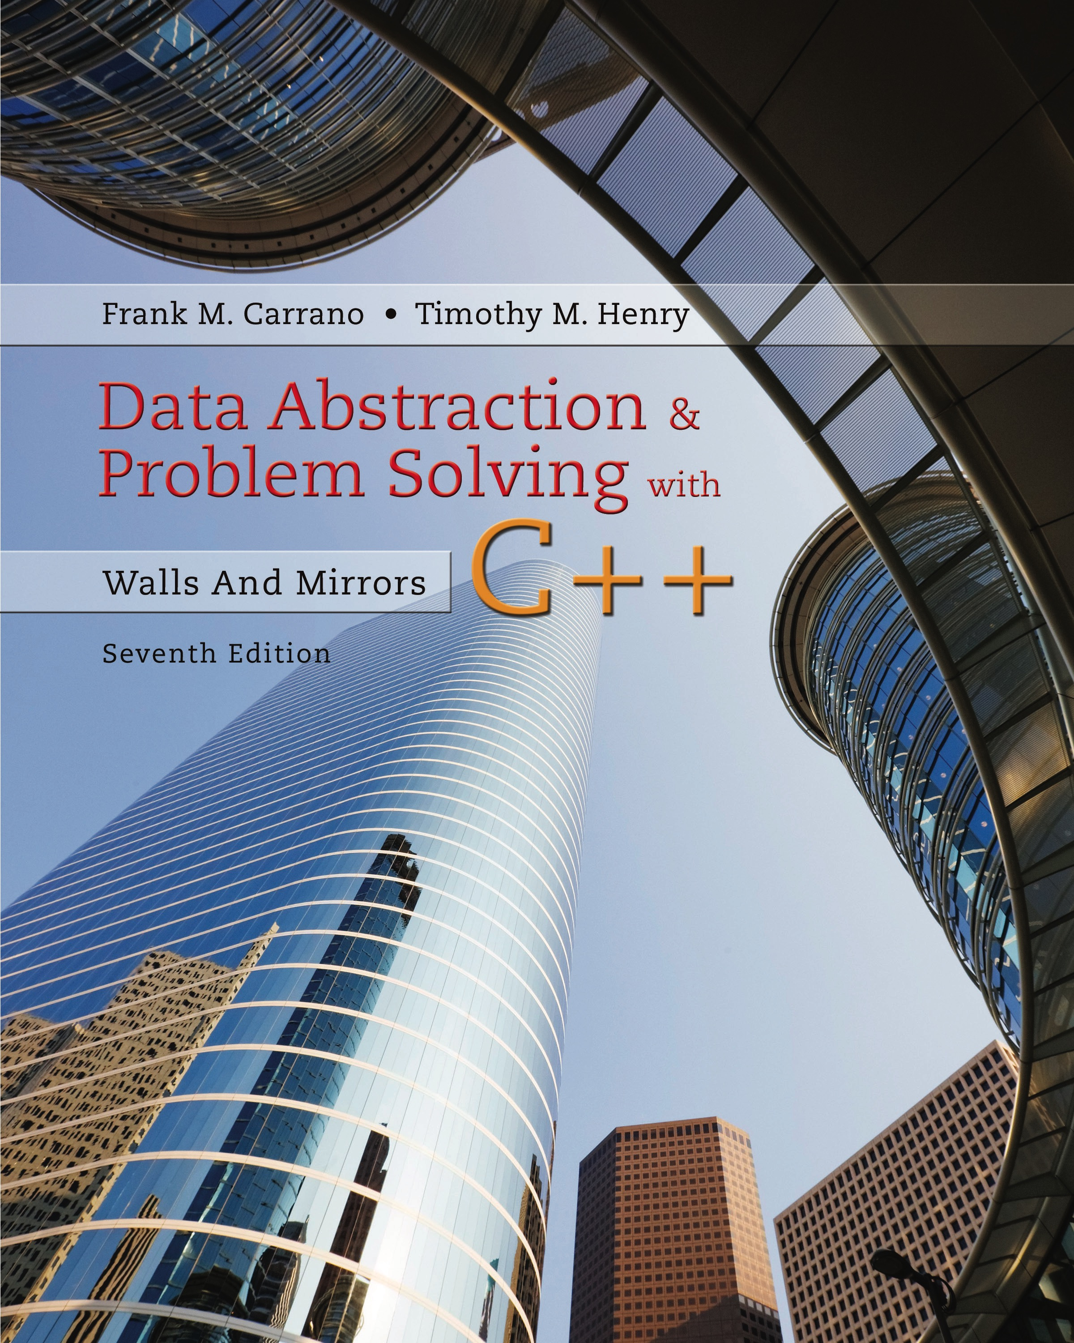
Data Abstraction & Problem Solving with C + +: Walls and Mirrors
Seventh Edition
Chapter 2
Recursion: The Mirrors
Copyright © 2017, 2013, 2007 Pearson Education, Inc. All Rights Reserved
Notes:
If this PowerPoint presentation contains mathematical equations, you may need to check that your computer has the following installed:
1) MathType Plugin
2) Math Player (free versions available)
3) NVDA Reader (free versions available)

Slide 2
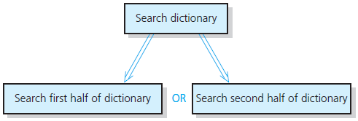
Recursive Solutions (1 of 3)
Recursion breaks problem into smaller identical problems
An alternative to iteration
Figure 2-1 A recursive solution

Slide 3
Recursive Solutions (2 of 3)
A recursive function calls itself
Each recursive call solves an identical, but smaller, problem
Test for base case enables recursive calls to stop
Eventually, one of smaller problems must be the base case

Slide 4
Recursive Solutions (3 of 3)
Questions for constructing recursive solutions
How to define the problem in terms of a smaller problem of same type?
How does each recursive call diminish the size of the problem?
What instance of problem can serve as base case?
As problem size diminishes, will you reach base case?

Slide 5
A Recursive Valued Function: The Factorial of n (1 of 2)
An iterative solution
for an integer n > 0
factorial (0)=1
A factorial solution
Note: Do not use recursion if a problem has a simple, efficient iterative solution

Slide 6
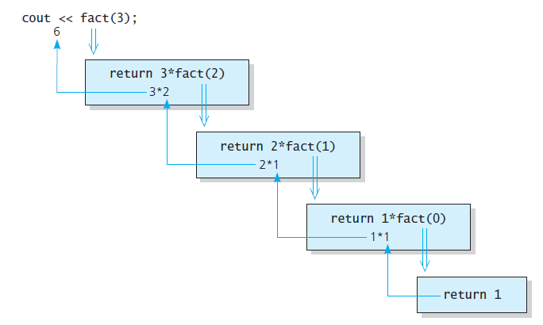
A Recursive Valued Function: The Factorial of n (2 of 2)
Figure 2-2 fact(3)

Slide 7
The Box Trace (1 of 7)
Label each recursive call
Represent each call to function by a new box
Draw arrow from box that makes call to newly created box
After you create new box executing body of function
On exiting function, cross off current box and follow its arrow back

Slide 8
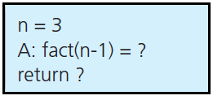
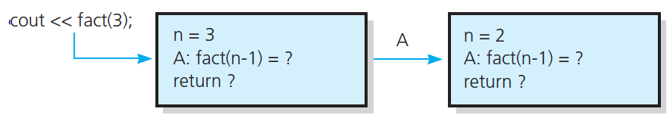
The Box Trace (2 of 7)
Figure 2-3 A box
Figure 2-4 The beginning of the box trace

Slide 9
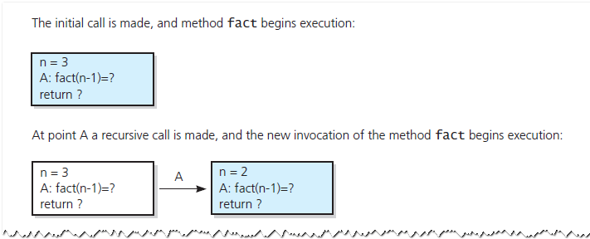
The Box Trace (3 of 7)
Figure 2-5 Box trace of fact(3)

Slide 10
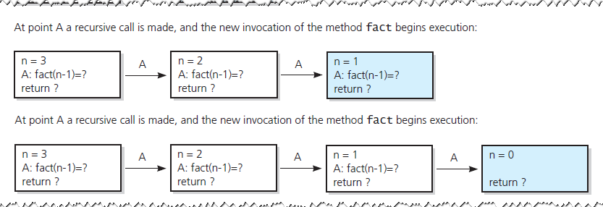
The Box Trace (4 of 7)
Figure 2-5 Box trace of fact(3)

Slide 11
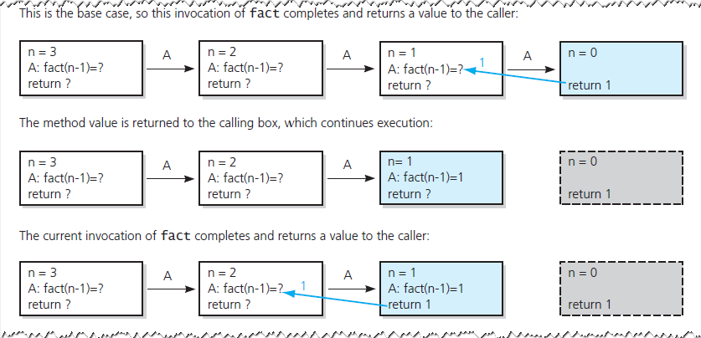
The Box Trace (5 of 7)
Figure 2-5 Box trace of fact(3)

Slide 12
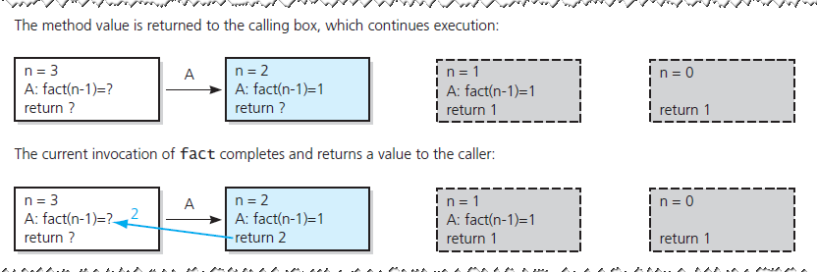
The Box Trace (6 of 7)
Figure 2-5 Box trace of fact(3)

Slide 13
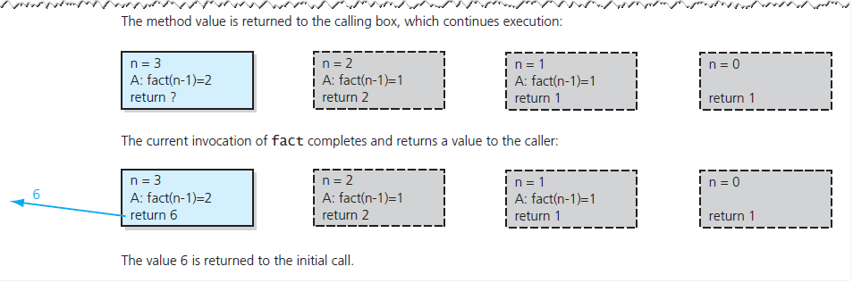
The Box Trace (7 of 7)
Figure 2-5 Box trace of fact(3)

Slide 14
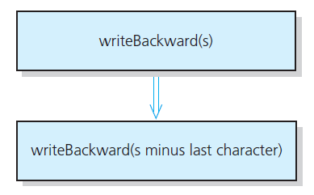
A Recursive Void Function: Writing a String Backward (1 of 17)
Likely candidate for minor task is writing a single character.
Possible solution: strip away the last character
Figure 2-6 A recursive solution

Slide 15
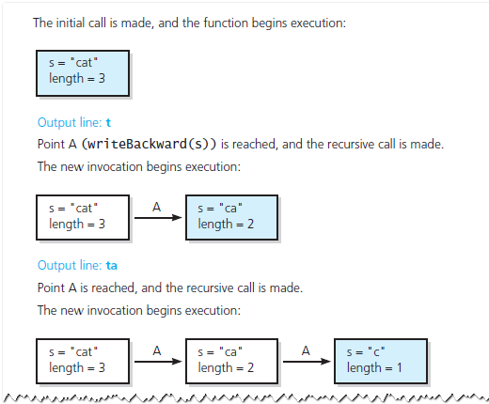
A Recursive Void Function: Writing a String Backward (2 of 17)
Figure 2-7 Box trace of writeBackward("cat")

Slide 16
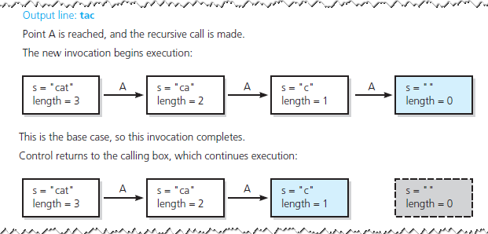
A Recursive Void Function: Writing a String Backward (3 of 17)
Figure 2-7 Box trace of writeBackward("cat")

Slide 17
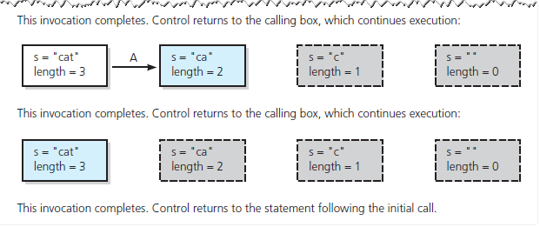
A Recursive Void Function: Writing a String Backward (4 of 17)
Figure 2-7 Box trace of writeBackward("cat")

Slide 18
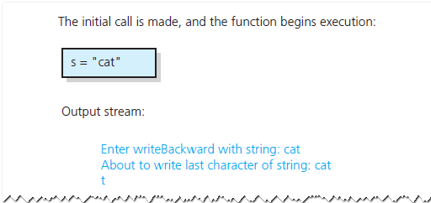
A Recursive Void Function: Writing a String Backward (5 of 17)
Another possible solution
Strip away the first character
Figure 2-8 Box trace of writeBackward("cat") in pseudocode

Slide 19
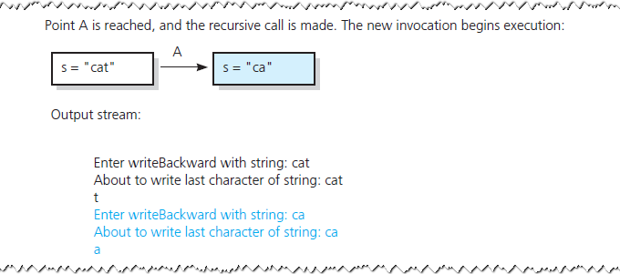
A Recursive Void Function: Writing a String Backward (6 of 17)
Figure 2-8 [Continued]

Slide 20
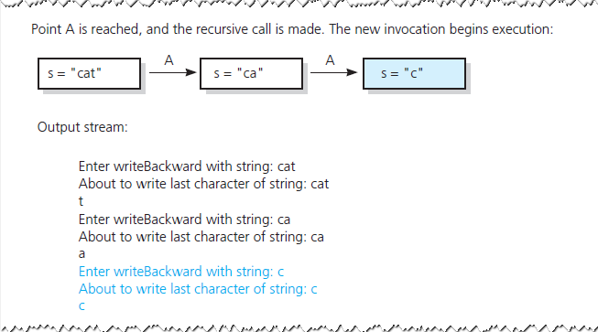
A Recursive Void Function: Writing a String Backward (7 of 17)
Figure 2-8 [Continued]

Slide 21
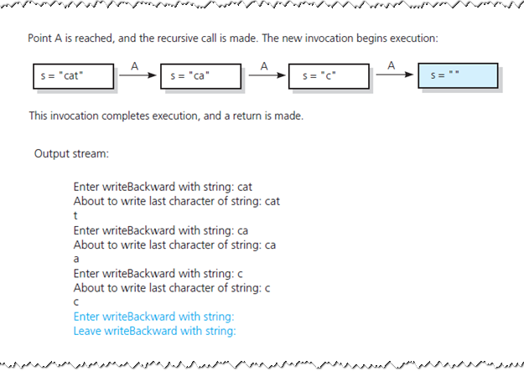
A Recursive Void Function: Writing a String Backward (8 of 17)
Figure 2-8 [Continued]

Slide 22
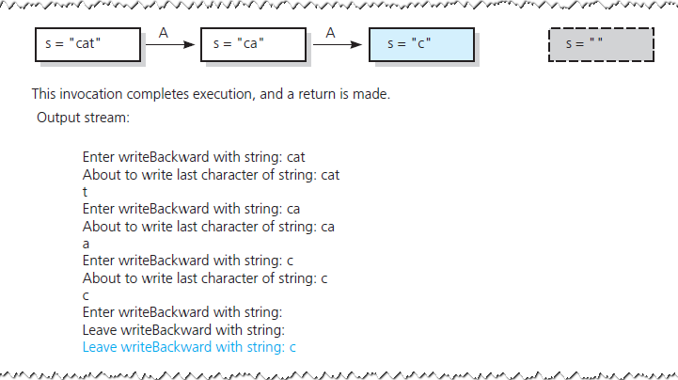
A Recursive Void Function: Writing a String Backward (9 of 17)
Figure 2-8 [Continued]

Slide 23
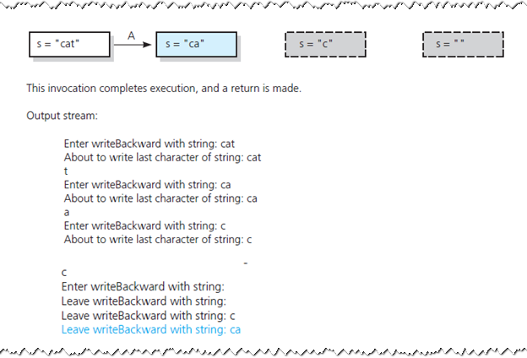
A Recursive Void Function: Writing a String Backward (10 of 17)
Figure 2-8 [Continued]

Slide 24
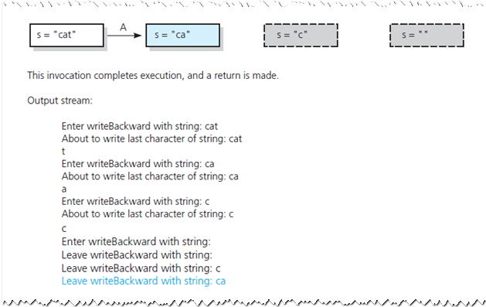
A Recursive Void Function: Writing a String Backward (11 of 17)
Figure 2-8 [Continued]

Slide 25
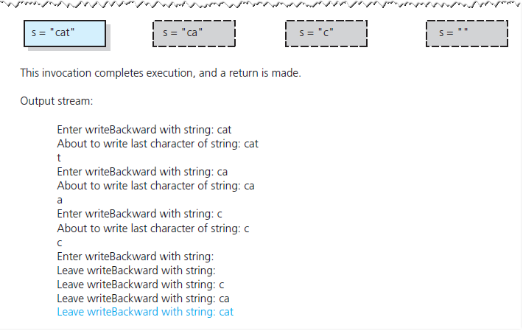
A Recursive Void Function: Writing a String Backward (12 of 17)
Figure 2-8 [Continued]

Slide 26
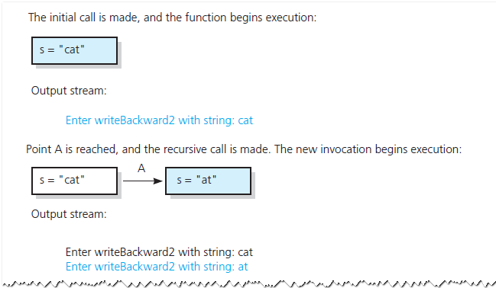
A Recursive Void Function: Writing a String Backward (13 of 17)
Figure 2-8 [Continued]

Slide 27
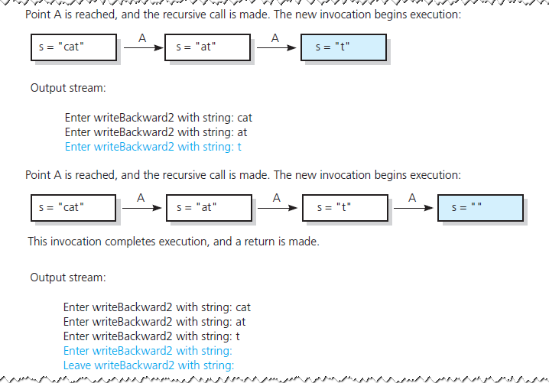
A Recursive Void Function: Writing a String Backward (14 of 17)
Figure 2-8 [Continued]

Slide 28
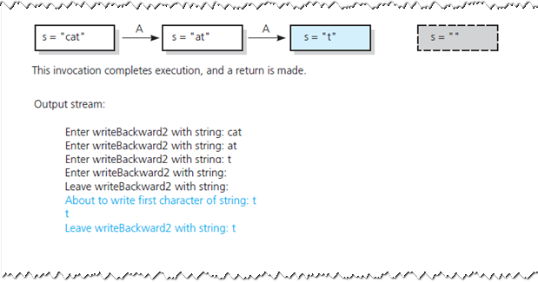
A Recursive Void Function: Writing a String Backward (15 of 17)
Figure 2-8 [Continued]

Slide 29
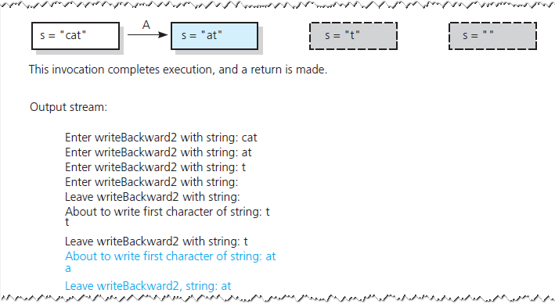
A Recursive Void Function: Writing a String Backward (16 of 17)
Figure 2-8 [Continued]

Slide 30
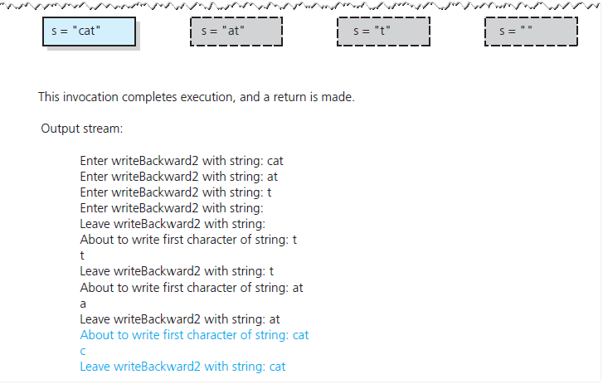
A Recursive Void Function: Writing a String Backward (17 of 17)
Figure 2-8 [Continued]

Slide 31
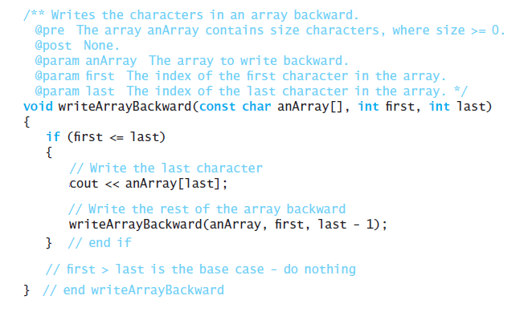
Writing an Array’s Entries in Backward Order
The function writeArrayBackward

Slide 32
The Binary Search (1 of 4)
Consider details before implementing algorithm:
How to pass half of anArray to recursive calls of binarySearch ?
How to determine which half of array contains target?
What should base case(s) be?
How will binarySearch indicate result of search?

Slide 33
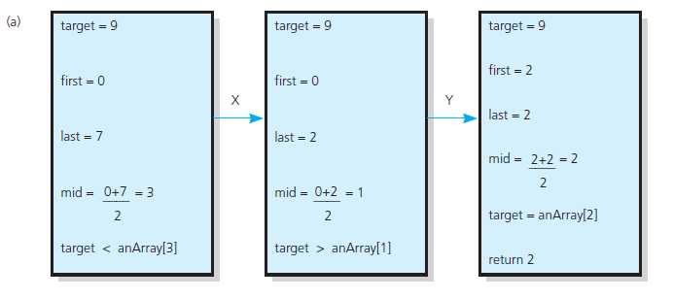
The Binary Search (2 of 4)
Figure 2-10 Box traces of binarySearch with anArray = <1, 5, 9, 12, 15, 21, 29, 31>: (a) a successful search for 9;

Slide 34
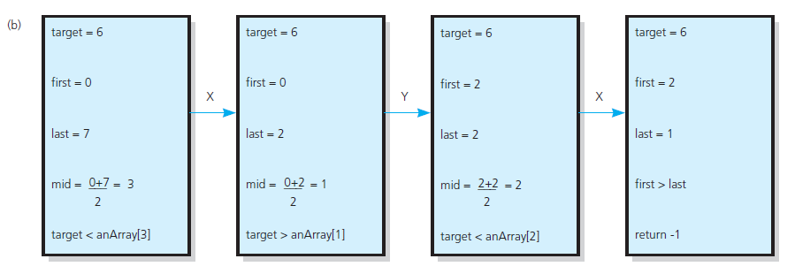
The Binary Search (3 of 4)
Figure 2-10 Box traces of binarySearch with anArray = <1, 5, 9, 12, 15, 21, 29, 31>: (b) an unsuccessful search for 6

Slide 35
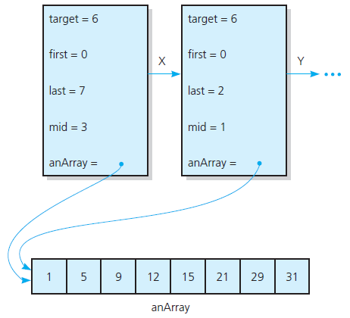
The Binary Search (4 of 4)
Figure 2-11 Box trace with a reference argument

Slide 36
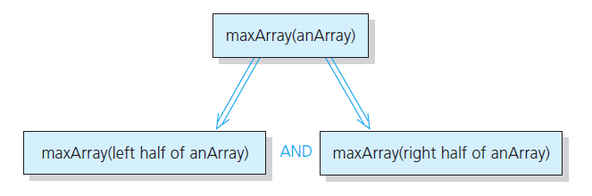
Finding the Largest Value in an Array (1 of 2)
Figure 2-12 Recursive solution to the largest-value problem

Slide 37
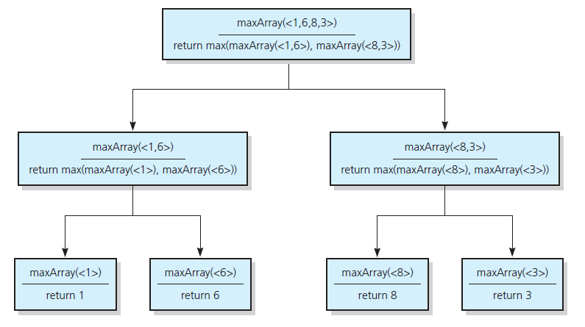
Finding the Largest Value in an Array (2 of 2)
Figure 2-13 The recursive calls that maxArray(<1,6,8,3>) generates

Slide 38
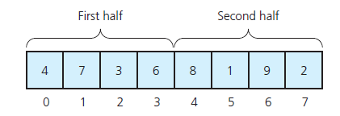
Finding K th Smallest Value of Array (1 of 2)
Recursive solution proceeds by:
Selecting pivot value in array
Cleverly arranging/ partitioning values in array about pivot value
Recursively applying strategy to one of partitions
Figure 2-14 A sample array

Slide 39
Finding K th Smallest Value of Array (2 of 2)
Figure 2-15 A partition about a pivot

Slide 40
The Towers of Hanoi (1 of 3)
The problem statement
Beginning with n disks on pole A and zero disks on poles B and C, solve towers(n, A, B, C).
Solution
With all disks on A, solve towers(n – 1, A, C, B)
With the largest disk on pole A and all others on pole C, solve towers(n – 1, A, B, C)
With the largest disk on pole B and all the other disks on pole C, solve towers(n – 1, C, B, A)

Slide 41
The Towers of Hanoi (2 of 3)
Figure 2-16 Solving the Towers of Hanoi puzzle
(a) The initial state:
(b) After moving n - 1 disks from A to C:
(c) After moving 1 disk from A to B:
(d) After moving n - 1 disks from C to B:

Slide 42
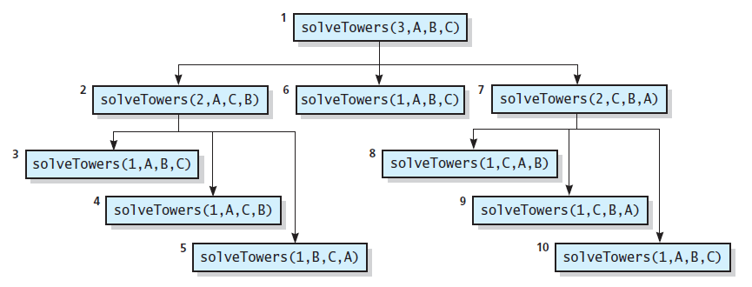
The Towers of Hanoi (3 of 3)
Figure 2-17 The order of recursive calls that results from solveTowers(3, A, B, C)

Slide 43
The Fibonacci Sequence (Multiplying Rabbits) (1 of 5)
Assume the following “facts” …
Rabbits never die.
Rabbit reaches sexual maturity at beginning of third month of life.
Rabbits always born in male-female pairs. At beginning of every month, each sexually mature male-female pair gives birth to exactly one male-female pair.

Slide 44
The Fibonacci Sequence (Multiplying Rabbits) (2 of 5)
Monthly sequence
One pair, original two rabbits
One pair still
Two pairs (original pair, two newborns)
Three pairs (original pair, 1 month old, newborns)
Five pairs …
Eight pairs …

Slide 45
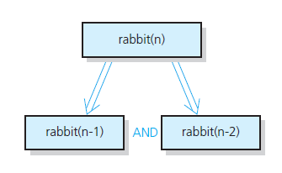
The Fibonacci Sequence (Multiplying Rabbits) (3 of 5)
Figure 2-18 Recursive solution to the rabbit problem (number of pairs at month n)

Slide 46
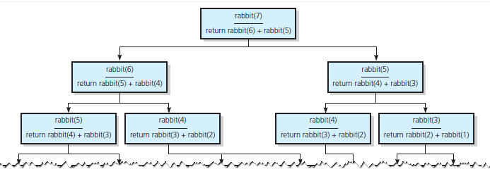
The Fibonacci Sequence (Multiplying Rabbits) (4 of 5)
Figure 2-19 The recursive calls that rabbit(7) generates

Slide 47
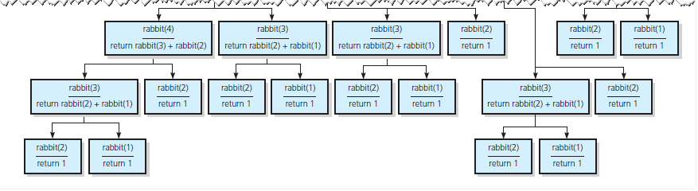
The Fibonacci Sequence (Multiplying Rabbits) (5 of 5)
Figure 2-19 [Continued]

Slide 48
Organizing a Parade (1 of 2)
Will consist of bands and floats in single line.
You are asked not to place one band immediately after another
In how many ways can you organize a parade of length n?
P (n) = number of ways to organize parade of length n
F (n) = number of parades of length n, end with a float
B (n) = number of parades of length n, end with a band
Then

Slide 49
Organizing a Parade (2 of 2)
Possible to see
P(1) = 2
P (2) = 3
Thus a recursive solution
Solve the problem by breaking up into cases

Slide 50
Choosing k Out of n Things (1 of 3)
Rock band wants to tour k out of n cities
Order not an issue
Let g( n, k ) be number of groups of k cities chosen from n
Base cases

Slide 51
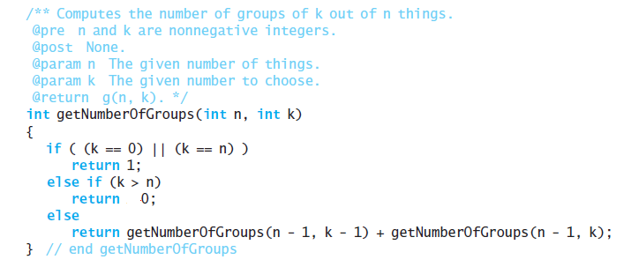
Choosing k Out of n Things (2 of 3)
Function for recursive solution.

Slide 52
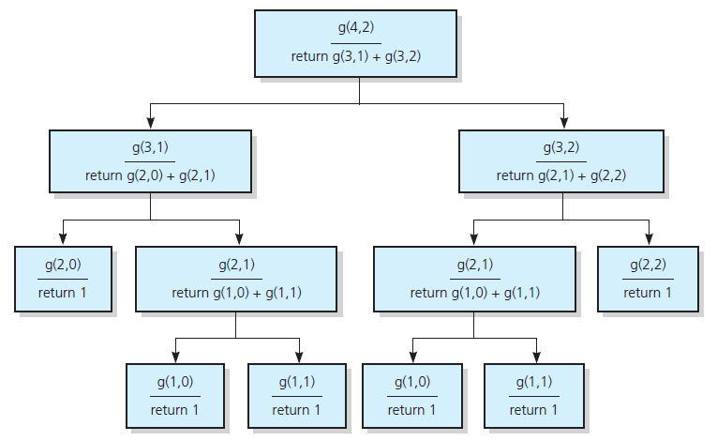
Choosing k Out of n Things (3 of 3)
Figure 2-20 The recursive calls that g (4, 2) generates

Slide 53
Recursion and Efficiency
Factors that contribute to inefficiency
Overhead associated with function calls
Some recursive algorithms inherently inefficient
Keep in mind
Recursion can clarify complex solutions … but …
Clear, efficient iterative solution may be better

Slide 54

Copyright

